Slide 1
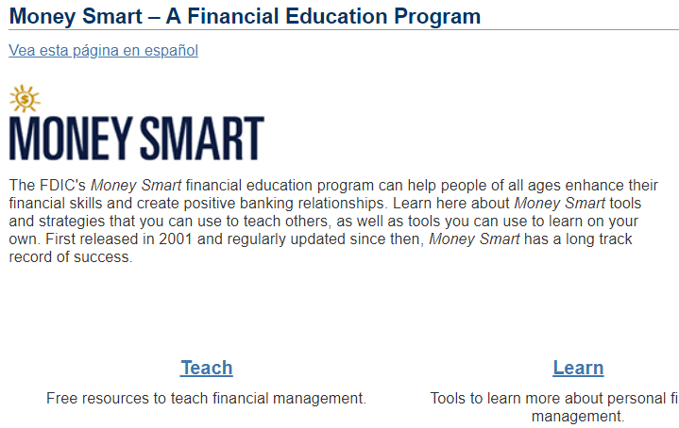
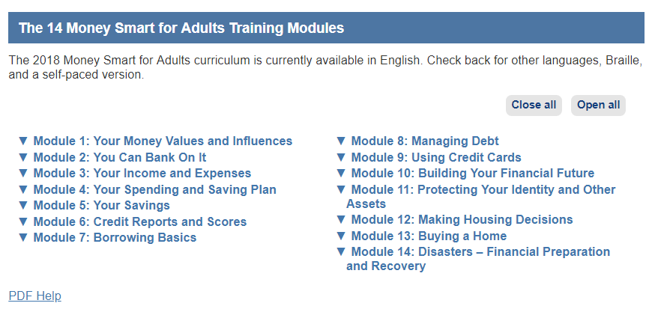
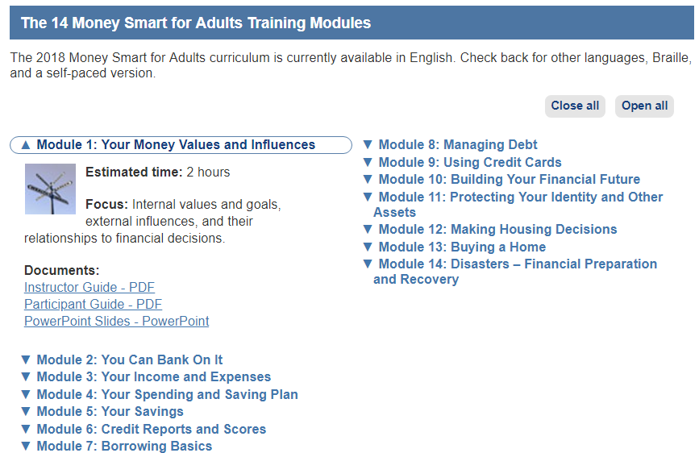
How to Get Money Smart for Adults
How to Download Money Smart for Adults Modules
Go to www.fdic.gov/moneysmart and click on “Teach”
Under Money Smart for Adults, click on “Learn More”
Scroll down to the list of modules
Each module expands when you select it and shows its components.

